Slide 1

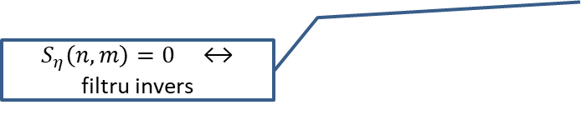
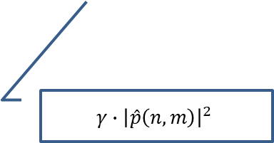
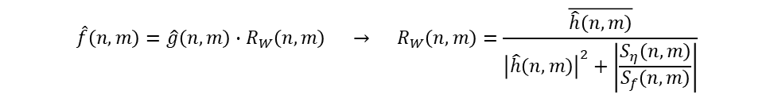
Model liniar de degradare: $g=\left(h⊗f\right)+η$ $\hat{g}=\hat{h}⋅\hat{f}+\hat{η}$
Impuls
(factor de degradare)
Imagine degradată
Imagine clară
Zgomot
Filtru invers
$$\hat{g}\left(n,m\right)=\hat{h}\left(n,m\right)⋅\hat{f}\left(n,m\right) → \hat{f}\left(n,m\right)=\hat{g}\left(n,m\right)∙\frac{1}{\hat{h}\left(n,m\right)} → f\left(x,y\right)=TFDI\left(\hat{g}\left(n,m\right)∙\frac{1}{\hat{h}\left(n,m\right)}\right)$$
Filtru median + invers
Filtru Wiener
Putere spectrală
zgomot
?
0 -1 0
-1 4 -1
0 -1 0
$$\hat{f}\left(n,m\right)=\hat{g}\left(n,m\right)∙R_{W}\left(n,m\right) → R_{W}\left(n,m\right)=\frac{\overline{\hat{h}\left(n,m\right)}}{{\left|\hat{h}\left(n,m\right)\right|}^{2}+\left|\frac{S_{η}\left(n,m\right)}{S_{f}\left(n,m\right)}\right|}$$
?
Putere spectrală
imagine clară
$S_{η}\left(n,m\right)=0$ ↔ filtru invers
=0 ? $→$ $R_{W}\left(n,m\right)=1$
Factor de ajustare (parametru)
$$γ∙{\left|\hat{p}\left(n,m\right)\right|}^{2}$$
Filtru Laplace
(uzual)

Slide 2
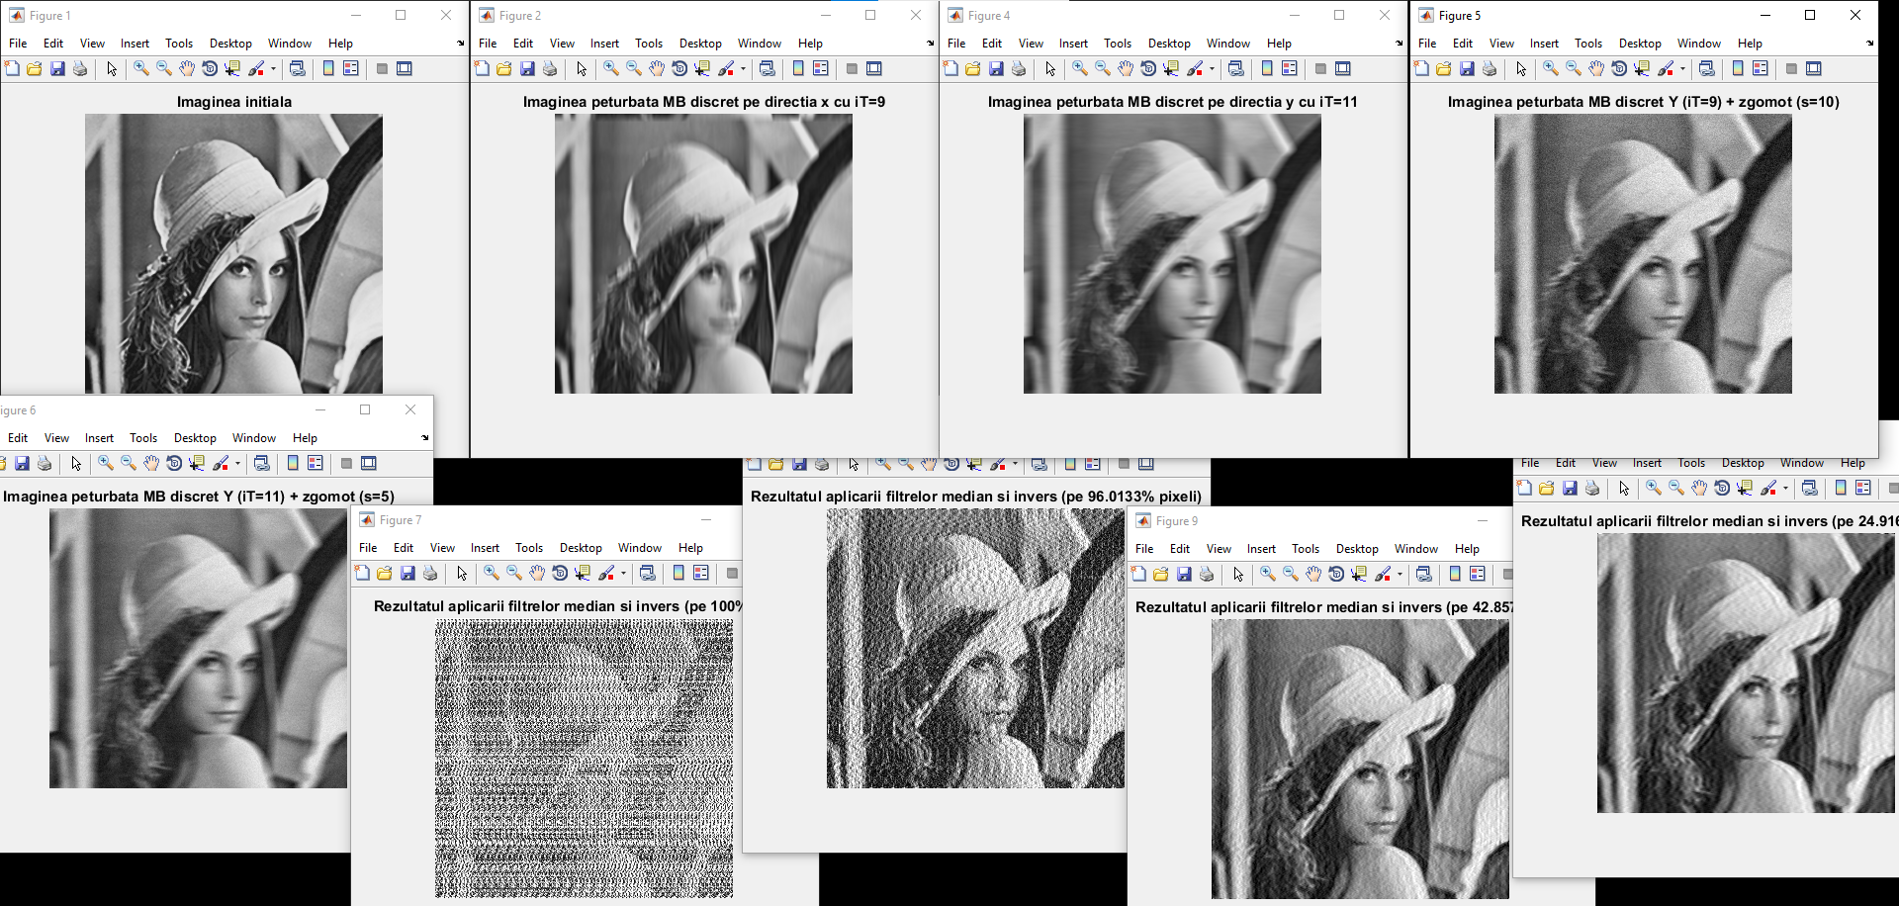

Slide 3
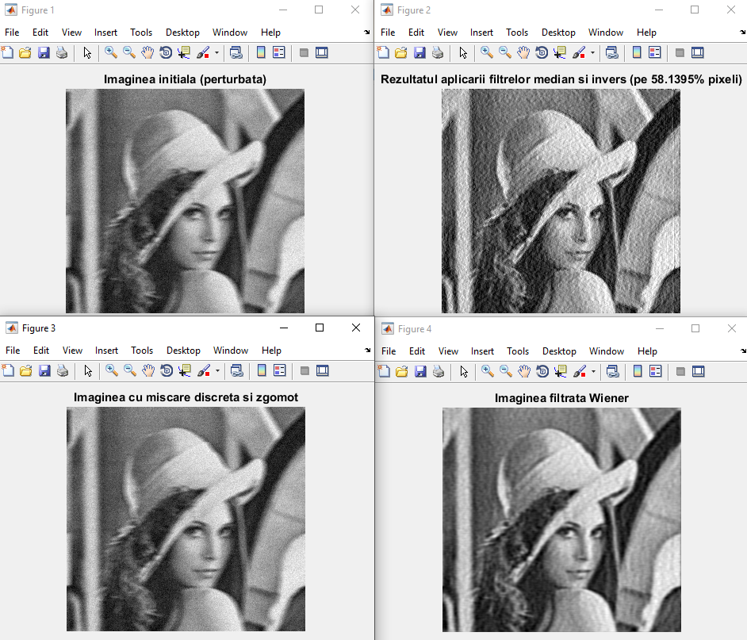
Filtru median + invers:
SNR: P: 11.4661 - R: 16.238
RMI: P: 0.16264 - R: 0.21268
Filtru Wiener:
SNR: P: 11.4661 - R: 19.752
RMI: P: 0.16264 - R: 0.29836

